Slide 1
INFERENTIAL STATISTICS
AISHWARYA R
BATCH-7230
PORJECT PRESENTATION -1

Slide 2
WHAT IS INFERENTIAL STATISTICS?
The sample is a set of data taken from the population .
To represent the population.
Probability distribution,hypothesis testing,correlation testing,regression analysis
All fall under the category of inferential statistics.

Slide 3
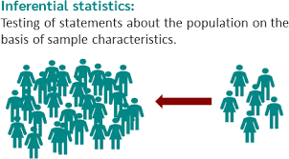
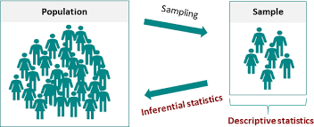

Slide 4
Inferential statistics have two main uses:
Making estimates about population (For example,the mean SAT score of all 11th graders in the US).
Testing hypothesis to draw conclusions about populations(for example,the relationship between SAT scores and family income).

Slide 5
Example for Inferential Statistics
A substitute teacher wants to know how students in the class did on their last test. The teacher asks the 10 students sitting in the front row to state their latest test score.He concludes from their report that the class did extremely well.What is the sample? What is the population? Can you identify any problems with choosing the sample in the way that the teacher did?

Slide 6
In the example, the population consists of all students in the class.The sample is made up of just 10 students sitting in the front row.
The sample is not likely to be representative of the population.Those who sit in the front row tend to be more interested in the class and tend to be more interested in the class and tend to perform higher on tests.Hence,the sample may perform at higher level than the population.

Slide 7
Advantages and Disadvantages
Advantages
We have many observations of the same thing.
This means we can use inferential statistics for large samples based on one entity.
Disadvantages
Samples are usually small.
Observations are not independent and identically distributed.

